Slide 1
GIS Data Types and Data Representations

Slide 2
Types of Data
Spatial Data
Non-Spatial Data
Geographic Location or Spatial Data
(where is it?)
Attribute data or Non-Spatial Data
(what is it?)

Slide 3
Spatial Data
By spatial data we mean data that contains positional values.
Spatial data describes the absolute and relative location of geographic features.
Geographic position specifies the location of a feature or phenomenon by using a coordinate system.

Slide 4
Attribute Data
Attribute or aspatial or non-spatial data
Data that describes characteristics of the spatial features or data. These characteristics can be quantitative and/or qualitative in nature. Attribute data is often referred to as tabular data.
The attributes refer to the properties of spatial entities such as identity (e.g. maize, granite, and lake), ordinal (e.g. ranking such as class 1, class 2, class 3) and scale (e.g. value such as water depth, elevation, erosion rate).
They are often referred to as non-spatial data since they do not in themselves represent location information.

Slide 5
Spatial Data and Attribute Data in GIS come together
Take the example of roads. To describe a road, we refer to its location (i.e., where it is) and its characteristics (e.g., length, name, speed limit and direction). The location represents spatial data, whereas its characteristics are attribute data.
Thus the feature road has two components spatial data as well as attribute data.

Slide 6
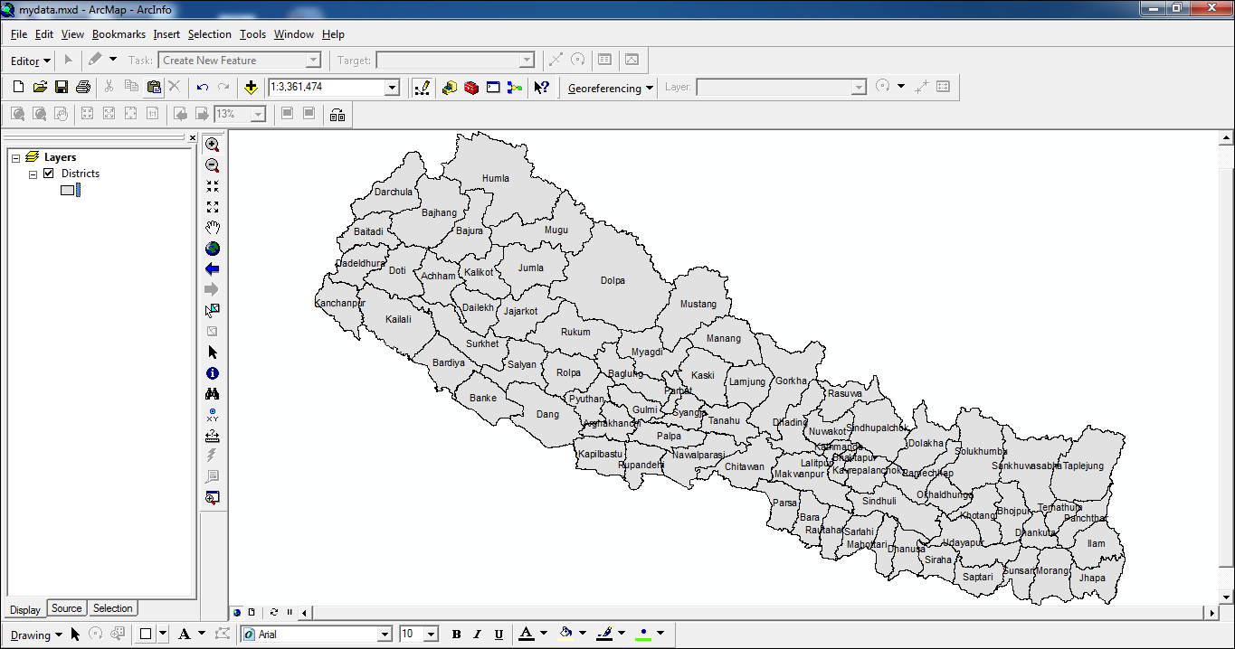
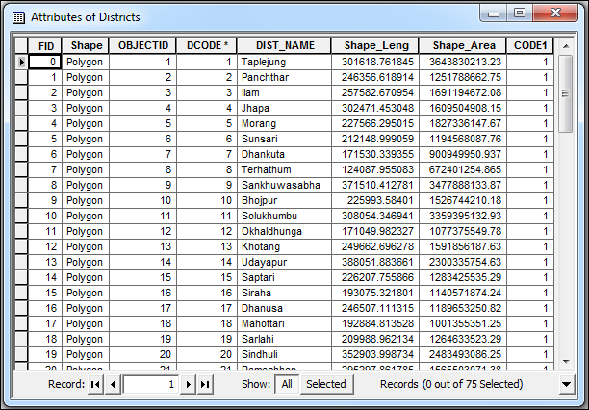
Spatial Data and Attribute Data

Slide 7
GIS Data Models | Formats | Representations

Slide 8
As discussed in earlier sessions, geographic phenomena has to be modelled and represented in computer understandable formats in order to process it.

Slide 9
Data Model / Formats
Vector Data Model
Raster
Data Model

Slide 10
Data Formats: Vector & Raster
Traditionally spatial data has been stored and presented in the form of a map.
There are two fundamental methods of representing geographical features to preserve geometry. They are:
Vector
Raster
Raster and Vector are two methods of representing geographic data in GIS.

Slide 11
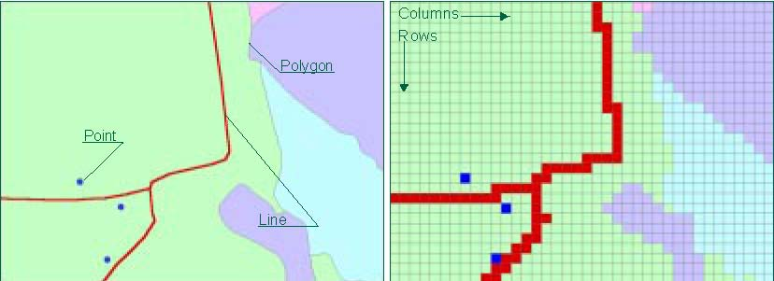
Data Formats: Vector & Raster
Spatial features in a GIS database are stored in either vector or raster form.
Figure |  | Figure
Vector format |  | Raster format

Slide 12
Vector Data
Spatial Features are represented as:
points
lines
polygons
Information about a feature is stored in an attribute table.
There can be many different attributes for each feature.

Slide 13
Vector Data: Point Data
A point is a 0 dimensional object and has only the property of location (x,y).
Points can be used to Model features such as a well, building, power, pole, spot height etc.
However, depending upon scale, other larger objects can also be modelled as vector data.

Slide 14
Vector Data: Line data
A line is a one-dimensional object that has the property of length.
Lines can be used to represent road, streams, boundary etc.

Slide 15
Vector Data: Polygon data
A polygon is a two-dimensional object with properties of area and perimeter
A polygon can represent a city, lake, river, etc.

Slide 16
Vector Data
Many entities can be represented in either point, line or polygon.
The choice depends upon the purpose of representations.
If we are concerned with road width, we need to represent it as polygon.
But if we are only interested in distances, roads can be represented as line.

Slide 17
Raster Data
Features are represented as square cells in a grid with one value per cell.
Examples of data in raster format - scanned aerial photographs, satellite images and scanned documents or maps.

Slide 18
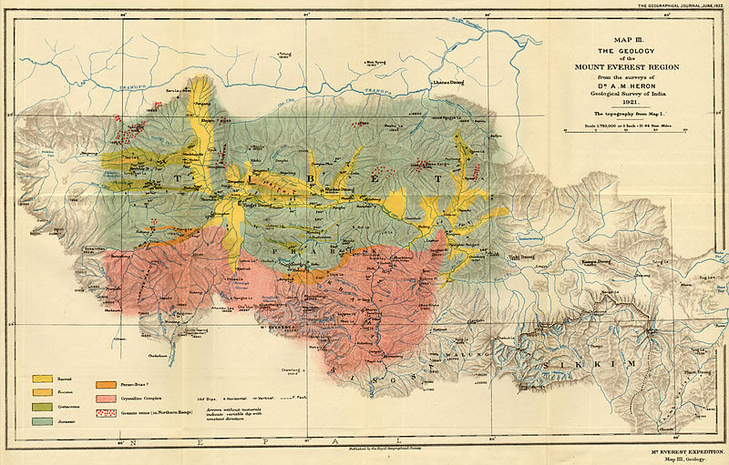
Scanned Map

Slide 19
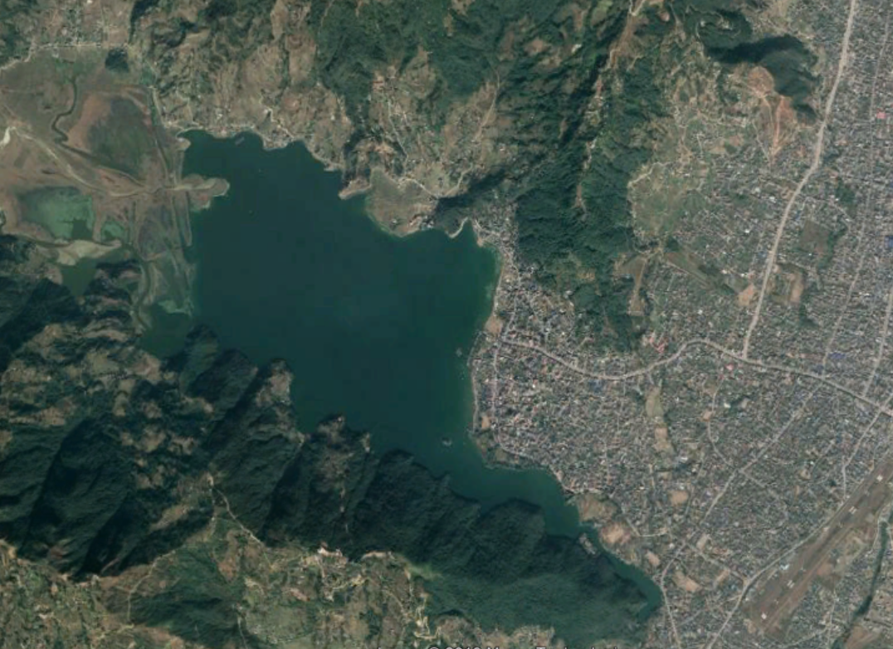
Satellite Imagery

Slide 20
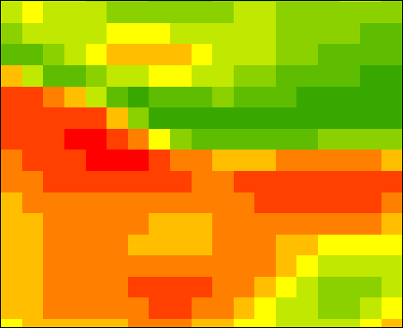
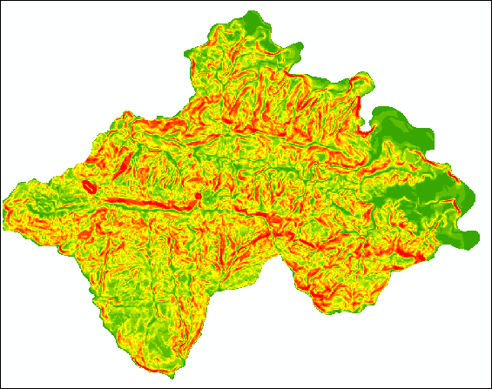
Landcover Landuse Maps

Slide 21
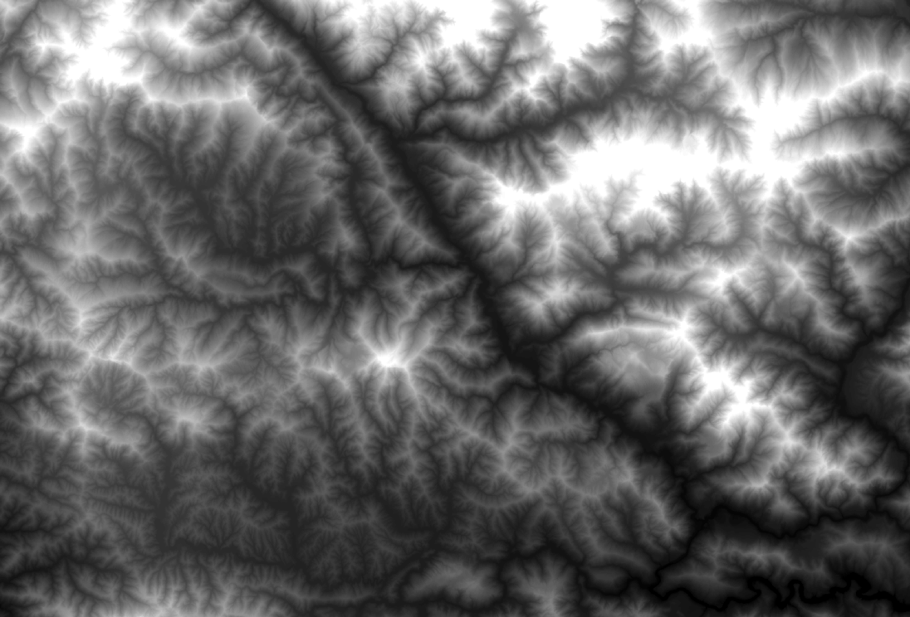
Digital Elevation Model (DEM)

Slide 22
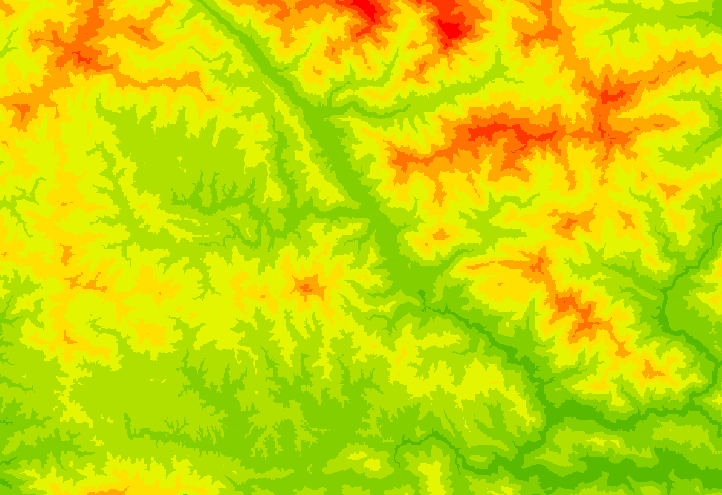
Digital Elevation Model (DEM)

Slide 23
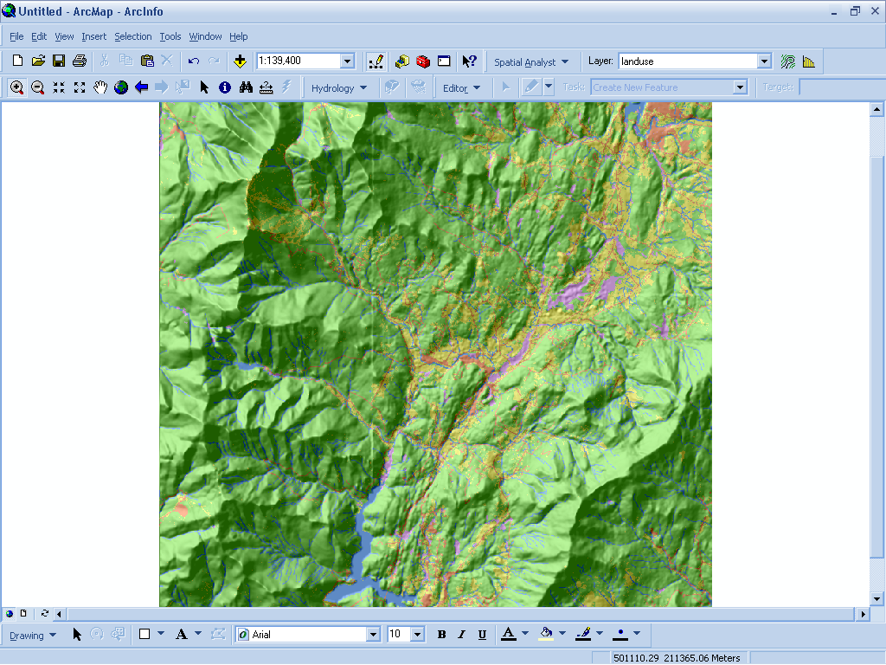
Digital Elevation Model (DEM) with Hill Shade

Slide 24
Choice of Raster and Vector Data Model
The choice of raster and vector data model depends on:
Type of Geographic Phenomena
Type of Analysis
Is also dependent on software algorithm (i.e input requirements and output given by software)

Slide 25
Choice of Raster and Vector Data Model
The choice of raster and vector data model depends on:
Type of Geographic Phenomena
Example : Geographic Field >> Raster Data Model
Geographic Objects >> Vector Data Mode

Slide 26
Choice of Raster and Vector Data Model
The choice of raster and vector data model depends on:
Type of Analysis
Example : Landuse change >> Raster Data Model
Network analysis >> Vector Data Model

Slide 27
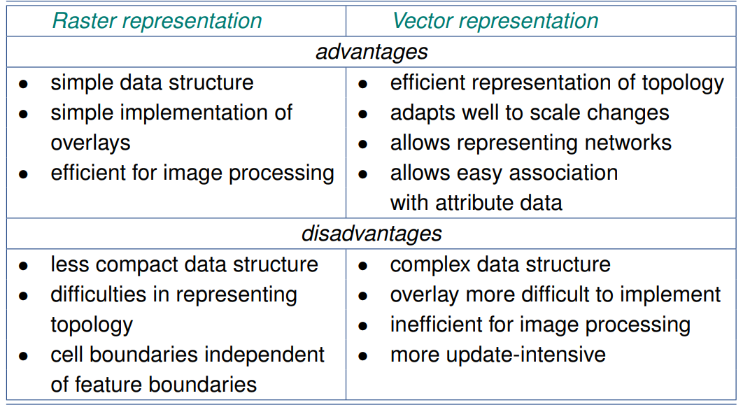
Advantages and Disadvantages of Raster and Vector Data Representation

Slide 28
Conversion of Raster and Vector Data
Vector
Raster
Point
Line
Zone of cells
Polygon
Notes:
DRM

Slide 29
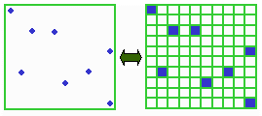
Points as Cells

Slide 30
Line as a Sequence of Cells

Slide 31
Polygon as a Zone of Cells

Slide 32
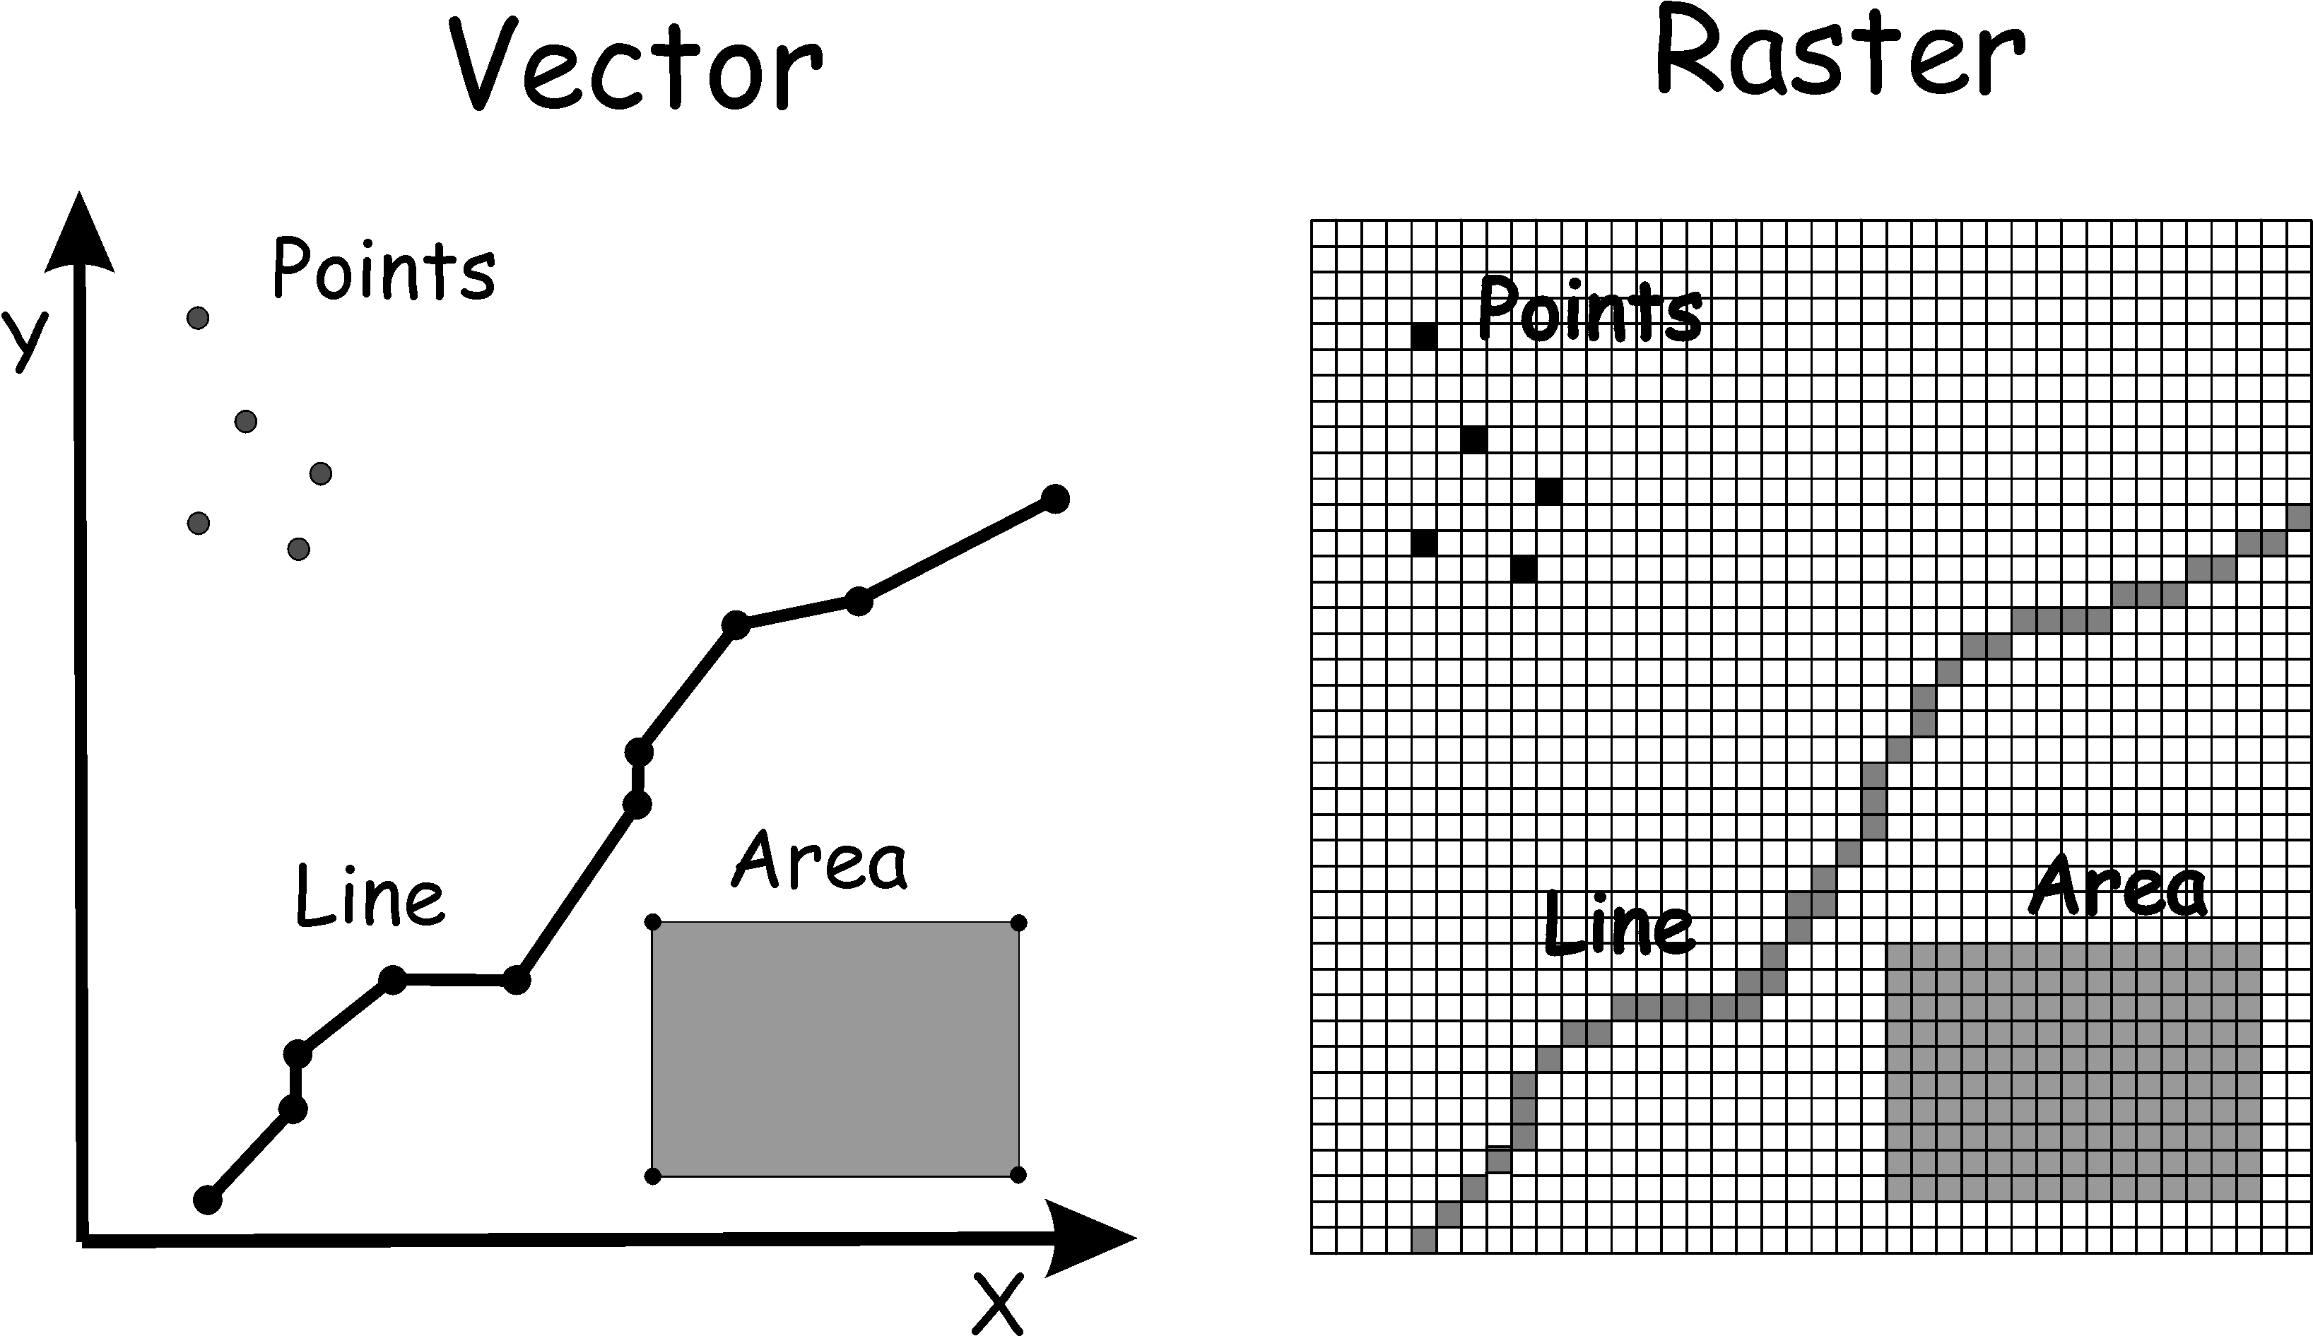
Conversion : Raster and Vector Data

Slide 33
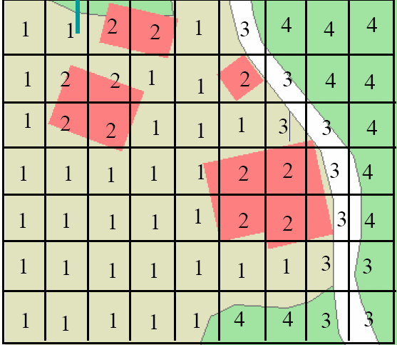
Resolution of raster
Each cell reprents an area of 10by 10 mters , the resolution is 10*10 meter
The size of the area that a single raster cell represents is called the raster’s resolution

Slide 34
TIN
Triangulated Irregular Network
A set of non-overlapping triangles each with a constant gradient.
It is built from a set of locations for which we have a measurement.
Observe that in three-dimensional space, three points uniquely determine a plane, as long as they are not positioned on the same line.

Slide 35
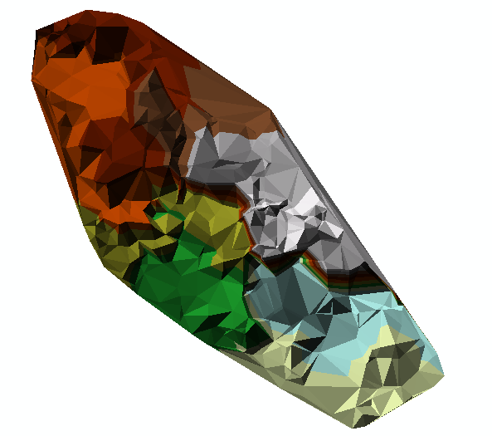

Slide 36
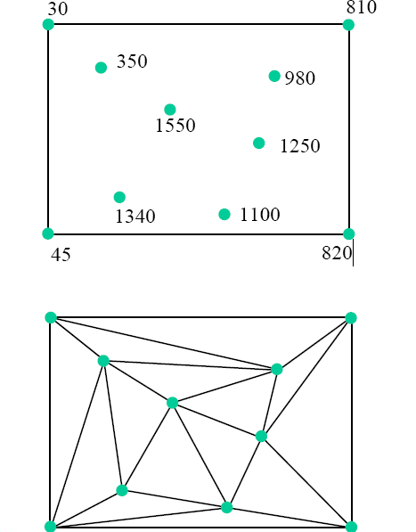
Triangulated Irregular Network (TIN)
A TIN is built from a set of measurements for example points of height.
These points can be scattered unevenly over the study area, with areas of more change having more points
Triangles are fitted through three points to form planes

Slide 37
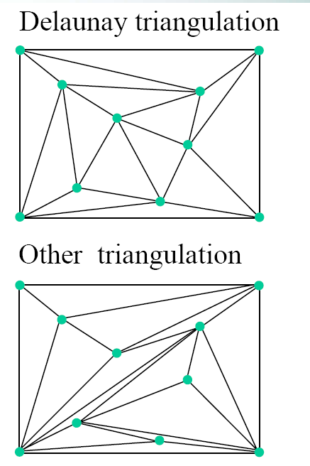
Triangulated Irregular Network (TIN)
There are many triangulations possible for the same input dataset
The best triangulations are Delaunay
triangulations which have the following
properties:
Triangles are as equal sided as possible
The circumcircle through its anchor points does not contain any other anchor points.

Slide 38
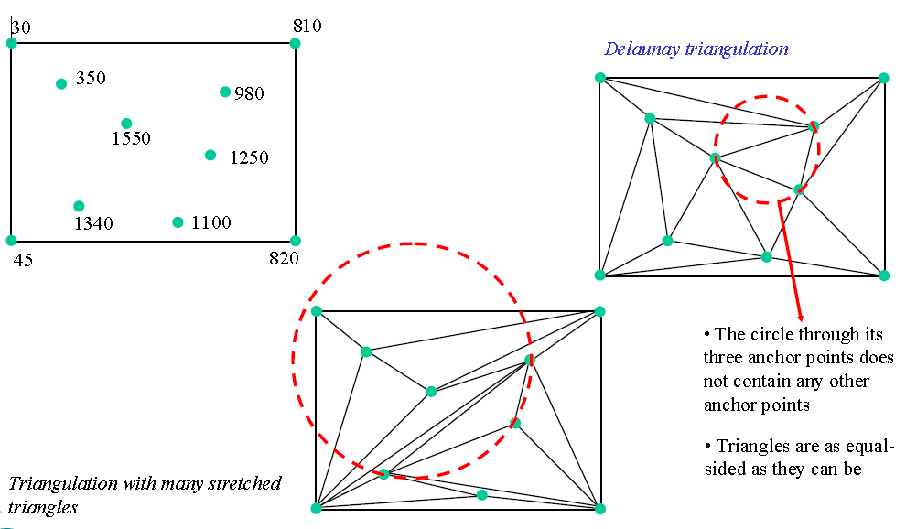
Triangulated Irregular Network (TIN)

Slide 39
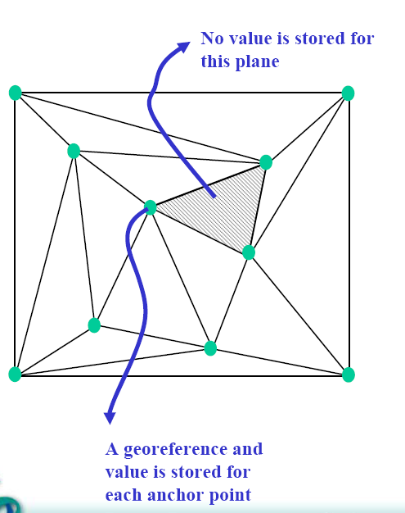
Triangulated Irregular Network (TIN)
A Tin is a vector representation and not an irregular tessellation because:
Each anchor point has a stored geo reference
The planes do not have a stored values (like raster cells have)

Slide 40
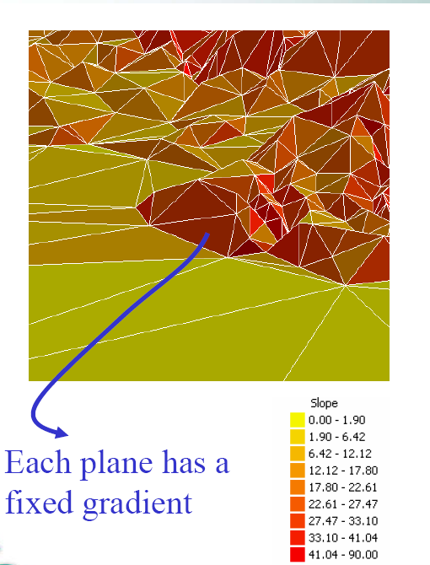
Triangulated Irregular Network (TIN)
Each plane fitted through three anchor points has a fixed gradient (Slope)
Each plane fitted through three anchor
points has a fixed aspect.
An aspect is the orientation of the slope, for example Northwest or Southeast

Slide 41
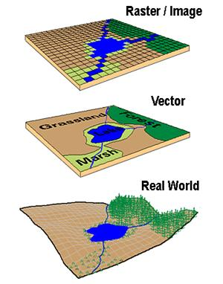
Real world to raster/vector data model
The diagram is the representation of the real world and showing differences in how a vector and a raster GIS will represent this real world.

Slide 42

Exercise
For the list of geographic phenomena enlisted earlier, you need to decide on which model would you choose. Also provide a reason with an example of its use.
Sn | Geographic Phenomena | Example Use | Type of Data Model

Slide 43

For all the geographic phenomena in a hydrological cycle, what data model would you use depending on the purpose.
Sn | Geographic Phenomena | Example Use | Type of Data Model

Slide 44
End

